Slide 1

GROUP-34
1. P. Kavya
2. M N Sahithi
3. E. Hima Sri
4. M. Gayathri
5. J. Yamini
6. G. Navya

Slide 2
Industry: Pharmaceutical Department: E-Commerce.
Problem Statement: Prediction of Medicine Production.

Slide 3
1. E-commerce in Pharmaceutical :
Pharma e-commerce is referred to an online pharmacy which operates on the internet and distributes medicines to consumers through mail and shipping companies. It is also known as online pharmacy, mail-order pharmacy or internet pharmacy.
2. Challenges in E-Pharmacy:
Fierce Competition. Reluctance to Buy Online. Ensuring Uninterrupted Supply. Expiry date and wastage. Keeping your stockroom efficient. Automating Inventory Management.

Slide 4
3.Working on: Expiry date and wastage.
4. Reasons for Expiry date and Wastage of Medicine :
The expiration date is a critical part of deciding if the product is safe to use and will work as intended. The expiration date can be found printed on the label or stamped onto the bottle or carton, sometimes following “EXP.” It is important to know and stick to the expiration date on your medicine. Using expired medical products is risky and possibly harmful to your health. Expired medical products can be less effective or risky due to a change in chemical composition or a decrease in strength. Certain expired medications are at risk of bacterial growth and sub-potent antibiotics can fail to treat infections, leading to more serious illnesses and antibiotic resistance. Once the expiration date has passed there is no guarantee that the medicine will be safe and effective. If your medicine has expired, do not use it.

Slide 5
FEATURE ENGINEERING
- Feature Creation:
Creating features involves creating new variables which will be most helpful for our model.
- Feature Transformation:
The featured transformation techniques are used to transform the data to normal distribution for better performance of the algorithm.
- Feature Extraction:
Feature extraction is a process by which an initial set of data is reduced by identifying key features of the data for machine learning.
- Feature Selection:
Feature Selection is the method of reducing the input variable to your model by using only relevant data and getting rid of noise in data.

Slide 6

Contents in dataset: 1. Demand rate 2. manufacturing 3. seasonal demand 4. delivery in time

Slide 7
Regression:
Models in Regression:
Linear Regression
Decision Tree Regression
Random Forest Regression
SVR

Slide 8
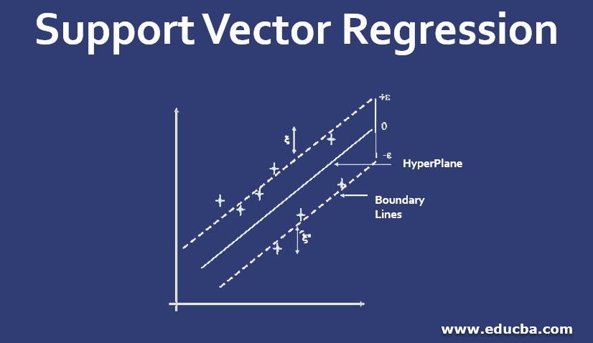
Result:
We can predict the production of medicine with accuracy of 99.8% in SVRegression.

